Slide 1






Towards Feasible Counterfactual Explanations A Taxonomy Guided Template-based NLG Method
Pedram Salimi, Nirmalie Wiratunga, David Corsar, Anjana Wijekoon
Code & Video
tinyurl.com/NATURALXAI
isee4xai.com

Slide 2
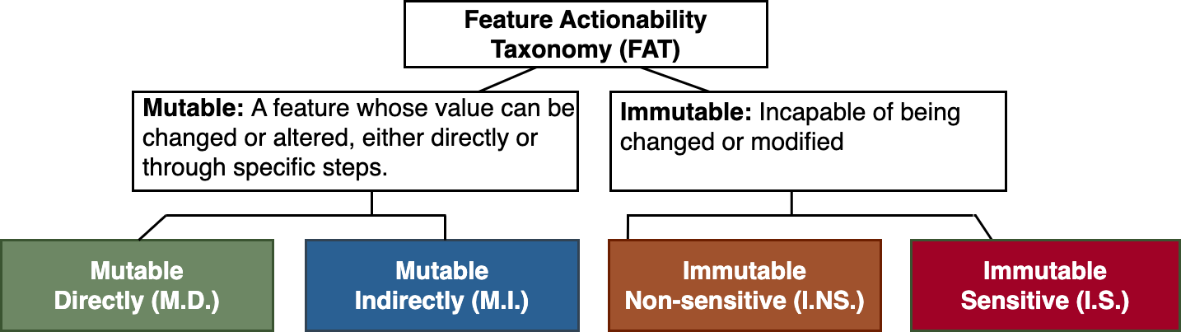
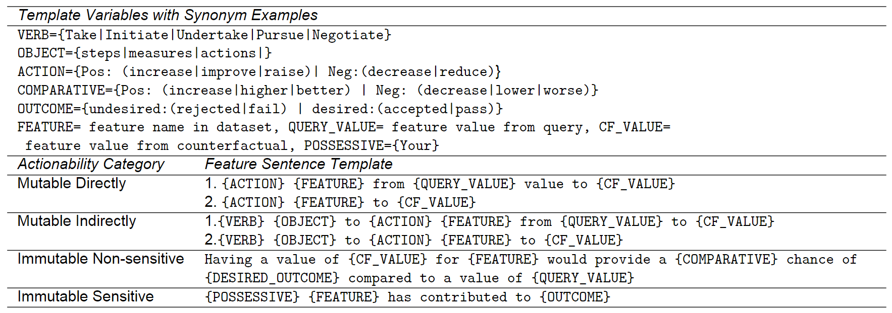
Counterfactual Natural-XAI Method
Immutable
Non-sensitive
Immutable
Sensitive
Mutable Directly
Mutable Indirectly
Feature Actionability Taxonomy
Actionability Sentence Template
Natural Language Explanation Sentence
Actionability Order
Feature
Query value
CF value
Feature Category
Natural language explanation grouped by Actionability Category and ordered by SHAP importance
Sentence Planning
Surface Realisation
Discourse Planning
1. Decrease loan amount from 13500.00 to 12000.00
2. Take steps to raise average current balance 19438.00 to 20500.00
Loan Amount
13500
12000
{ACTION} {FEATURE} from {QUERY VALUE} value to {CF VALUE}
Decrease loan amount from 13500 to 12000
Average current balance
19438.00
20500.00
{VERB} {OBJECT} to {ACTION} {FEATURE} from {QUERY VALUE} value to {CF VALUE}
Take steps to raise average current balance 19438.00 to 20500.00
3. Your gender has contributed to loan rejection
Loan Grade
E
B
Having a value of {CF VALUE} for {FEATURE} would provide a {COMPARATIVE} chance of {DESIRED OUTCOME}…
Having a value of B for loan grade would provide a higher chance…
Gender
Male
Female
{POSSESSIVE} {FEATURE} has contributed to {OUTCOME}
Your gender has contributed to loan rejection
4. Having a value of B for loan grade would provide a higher chance of acceptance compared to loan grade E
Notes:
The animations match speech below. Given an FAT and templates for a dataset (show FAT and template), our algorithm has 3 steps which is described using an example (rest of the animation starts).

